Slide 1
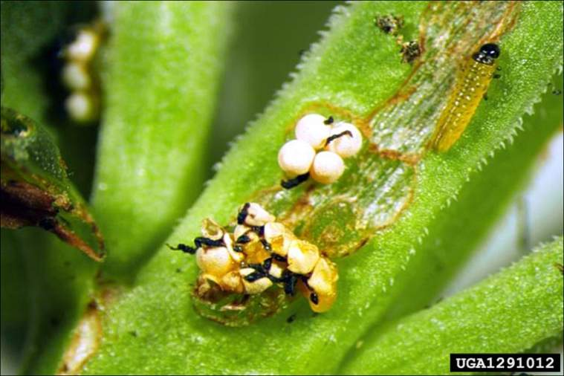
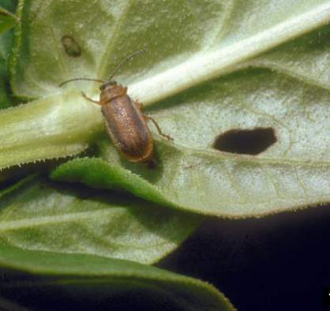
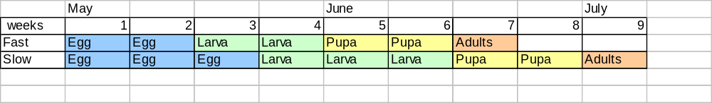
Eggs
Adult
Larva
Eric Coombs,
Oregon Department
of Agriculture, United States
Bernd Blossey, Cornell University, United States
Galerucella beetles go through 4 stages of life. Egg, Larva, Pupa, and Adult. Adults hibernate over the winter, and begin laying eggs in the spring.

Slide 2
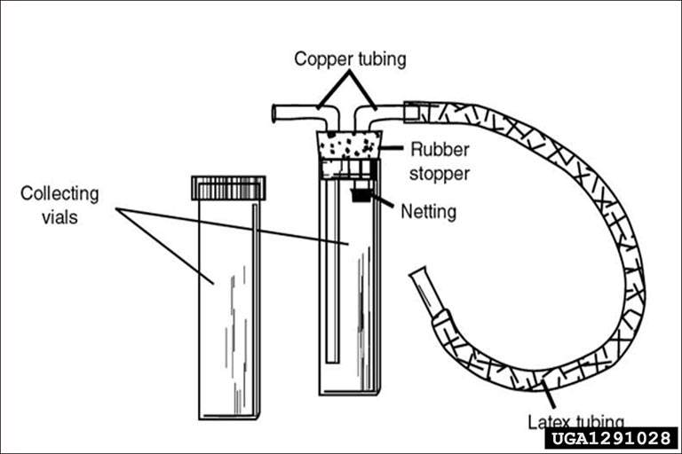
When adult beetles first emerge in the spring, people use a tool like this to collect them safely. They emerge near the time lilacs bloom.
Karen Loeffelman, University of Idaho, Bugwood.org

Slide 3
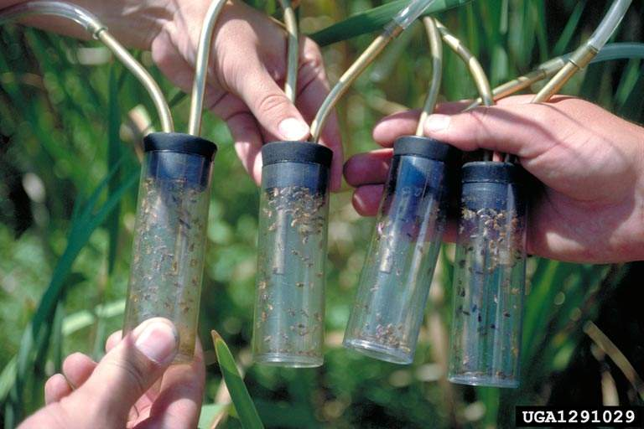
Gary L. Piper, Washington State University, Bugwood.org
Adults are tranported in vials.

Slide 4
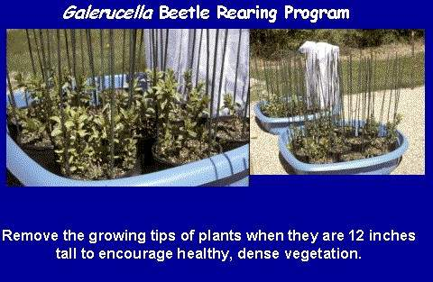
Remove other insects, and spiders so the adults will not be eaten.

Slide 5
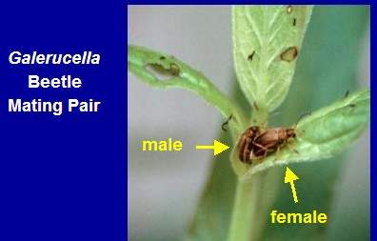
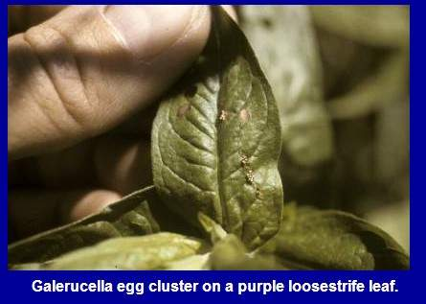
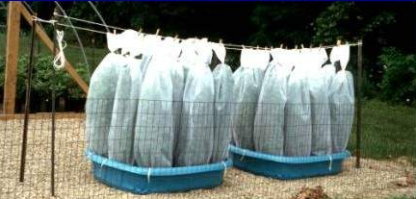
Beetle Rearing
Purple loosestrife is dug up for the adult beetles to feed on, and to lay eggs on. 10-15 beetles per plant produce thousands of eggs!

Slide 6
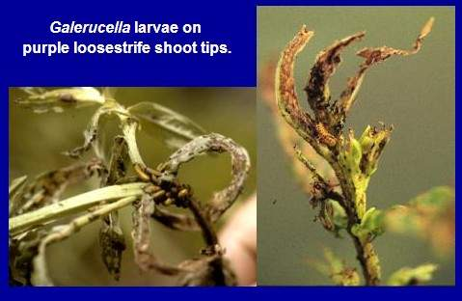
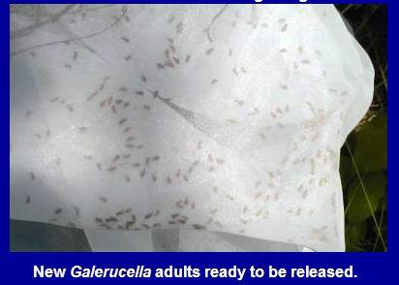
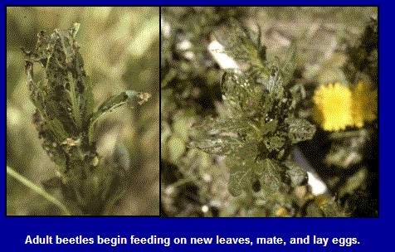
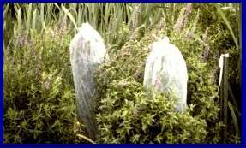
Release and Damage

Slide 7
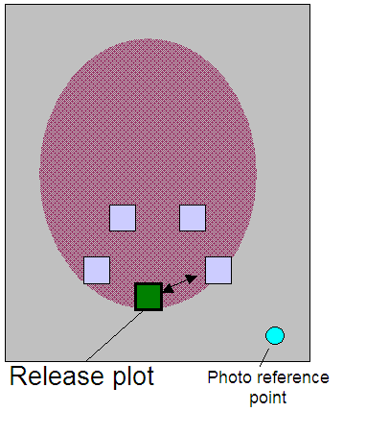
Monitoring
Standard methodology used across the U.S.
Monitoring plots are 1x1 m quadrats, marked with wood stakes or PVC pipe.
Monitor twice each year for at least three years.
Take photos of site and plots from consistent spots to be able to compare one season/year to the next. Label photos!

Slide 8
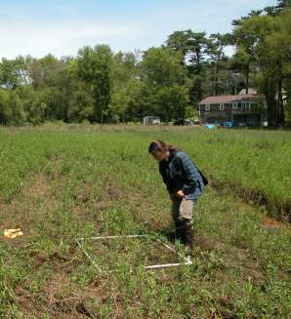
Monitoring
Visual assessment of the abundance of Galerucella eggs, larvae, and adults,
Estimation of damage to purple loosestrife plants,
Estimated percent cover of loosestrife (Lythrum) and Cattail (Typha)
Height of five tallest loosestrife (Lythrum) and Cattail (Typha) stems,
Qualitative and quantitative observations of other insect and plant species.

